Slide 1
Earthquake Prediction
Saroj Raut
DSC 530
Data Exploration and Analysis

Slide 2
Introduction
Earthquake is a challenging problem which researchers have been trying to solve for years but with little success. A solution to this problem can save thousands of innocent lives and revolutionize disaster management. Some regions really have frequent earthquakes, but this is just a comparative quantity compared to other regions.
Hypothesis testing is an essential part of the scientific method, and it is especially important in earthquake prediction because public safely, public funds, and public trust are involved.

Slide 3
Can earthquake be predicted?
I would like to analyze and explore the date available to prepare our final dataset for model exploration.
Metadata will be studied to understand the independent and dependent variable within the dataset.
Data will be prepared for building meaningful relationship between the variables. Various plot and graph will be constructed to visualize and establish relationship within the variables.

Slide 4
Metadata
This dataset includes a record of the date, time, location, depth, magnitude, and source of every earthquake with a reported magnitude 5.5 or higher since 1965.
Date: The date when the earthquake initiates rupture, which is known as the "origin" time.
Time: The time when the earthquake initiates rupture, which is known as the "origin" time.
Magnitude: Earthquake magnitude is a logarithmic measure of earthquake size.
Latitude: An earthquake begins to rupture at a hypocenter which is defined by a position on the surface of the earth (epicenter) and a depth below this point (focal depth). The latitude is the number of degrees north (N) or south (S) of the equator and varies from 0 at the equator to 90 at the poles.

Slide 5
Metadata
Longitude: An earthquake begins to rupture at a hypocenter which is defined by a position on the surface of the earth (epicenter) and a depth below this point (focal depth). The longitude is the number of degrees east (E) or west (W) of the prime meridian which runs through Greenwich, England. The longitude varies from 0 at Greenwich to 180 and the E or W shows the direction from Greenwich.

Slide 6
Data Preparation
Final dataset is prepared by dropping the columns of the data frame that are not important for analysis.
Data is formatted to make it readable and null values were dropped from the final dataset.
Data is enhanced by creating new column for year.

Slide 7
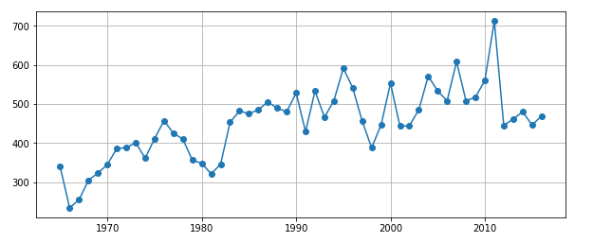
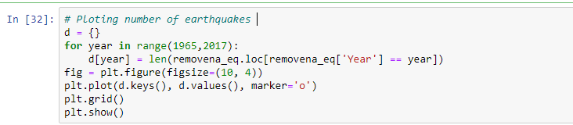
Date
Plotting the no. of earthquakes.
Trend in number of earthquakes year wise.
This clearly shows a decrease in number of earthquakes each year since 2012

Slide 8
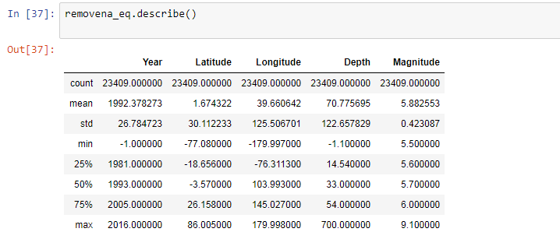
characteristics
Summary of the data.
Mean, std, count, etc.

Slide 9
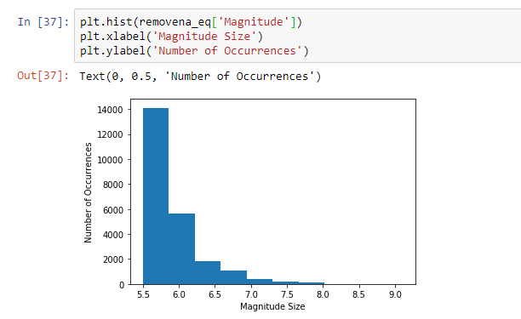
Relationship
Magnitude vs No. of occurrences
Earthquakes in the range on 5.5 magnitude is more often than earthquake in the range of 7 and above.

Slide 10
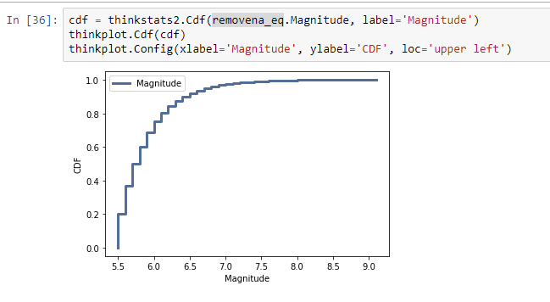
CDF for Magnitude
CDF for magnitude that maps from a value to its percentile rank.

Slide 11
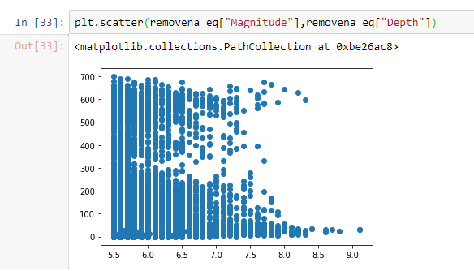
Depth vs Magnitude Relationship
Relationship is studied between different variables such as Depth vs Magnitude.
There are few cases in which even though depth was not high, yet the Magnitude of Earthquake is too high

Slide 12
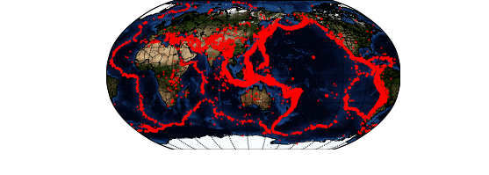
Finding
Locations of earthquake around the world.
The data was preprocess using python to eliminate unwanted variables and missing values. The clean dataset was confirmed to be used for the further analysis and finding.
The dataset was used to visualized earthquake frequency and distribution across the world since 1965. Most of the earthquakes are close to a magnitude of 6, and there are very few cases which exceed the grade of 7 along all the years. Earthquake activity looks slightly like the map of the earth's tectonic plates. The places located the closest to the limit of those plates are the zones with the highest activity.
I am unable to establish correlation to predict earthquake. My study will continue to work on this project as I work to get more comfortable working with python.

